Slide 1

Community Captioner

Slide 2
Team CC
Team Lead (Amgen)
Team Members (USC)
Ely Lerner
Jeffrey Chan
Chaitanya Ramavajjala
Chetan Sharma
Raed Shomali

Slide 3
Concept
Our project concept is an open source, community-driven online video closed captioning tool. This tool will help hearing impaired people experience the wealth of online “Web 2.0” media content available today with no captions. We our most likely going to scope the project to YouTube given the timeframe but it would be idea to eventually allow captioning of all types of media so our backend application will be written with this in mind.

Slide 4
Phase A Summary
"Our project is a community-driven web media captioning tool, it's important because the hearing-impaired community cannot fully experience much of the “Web 2.0” video content currently available online, it's difficult because the team does not have a lot of experience with manipulating FLV media, and we are confident we can do it because we have a strong team, good design, are in the process of extensive research on the subject, and have a strong motivation to succeed."

Slide 5
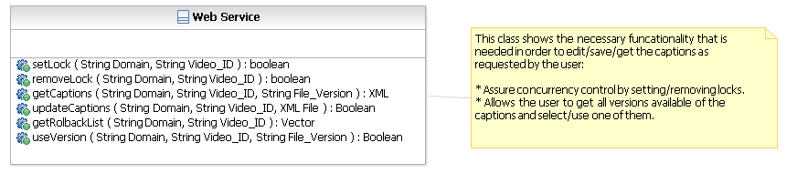
SA: Class Diagram

Slide 6
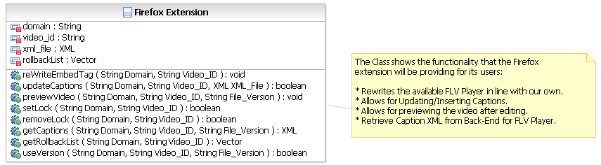
SA: Class Diagram

Slide 7
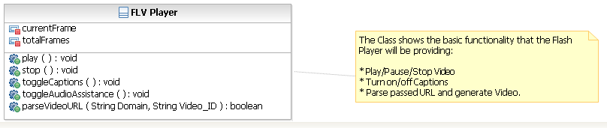
SA: Class Diagram

Slide 8
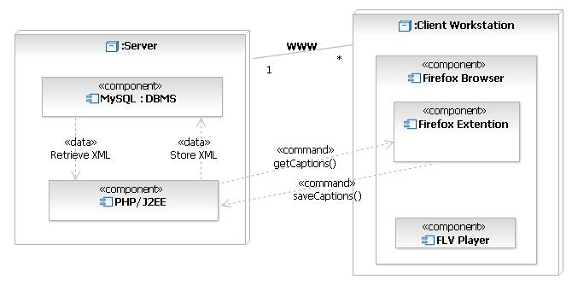
SA: Deployment Diagram

Slide 9
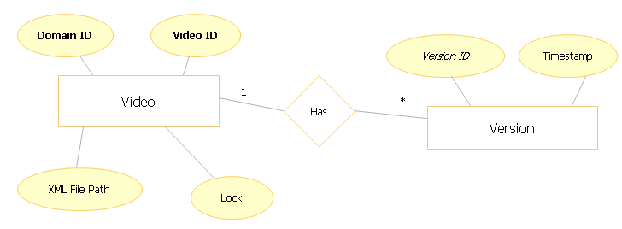
SA: Database Diagram

Slide 10
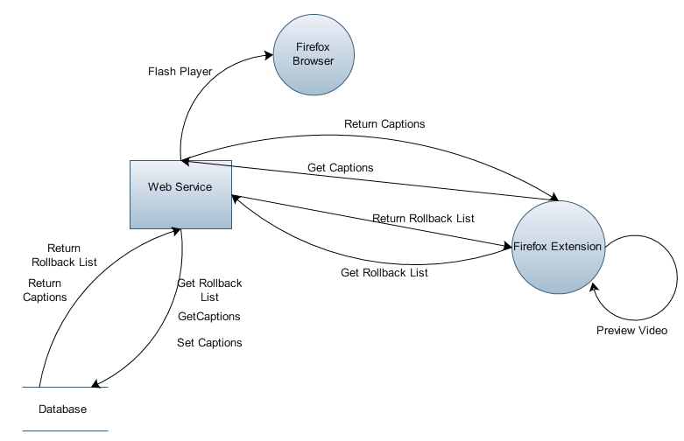
SA: DFD
Indicates the data flow pertaining to
  Retrieving captions
  Retrieving rollback list
  Preview the captioned video
  Writing the Flash Player on
  the Browser (Website)
  Setting the Captions

Slide 11
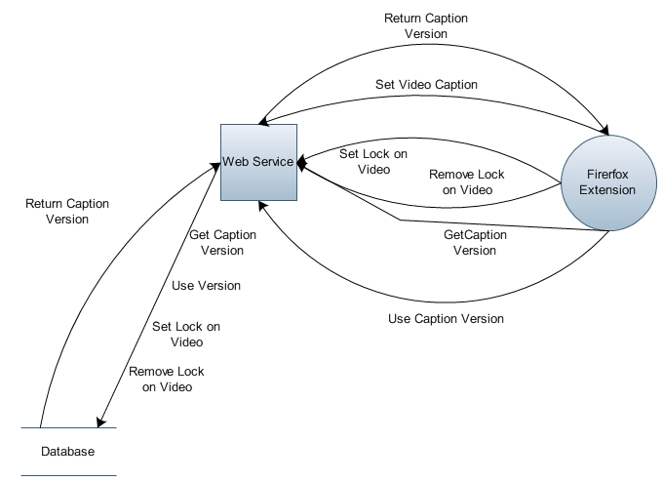
SA: DFD
Indicates the data flow pertaining to
  Acquiring the lock on the caption
  Releasing the lock on the caption
  Resetting a caption to its previous
  version.
  Retrieving a version of the
  caption

Slide 12
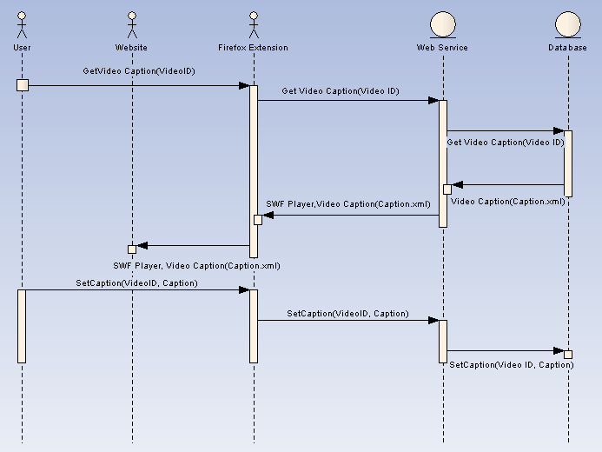
SA: Sequence Diagram
Get captions for a video.
Write the Flash player on the website and play the video.
Save the caption.

Slide 13
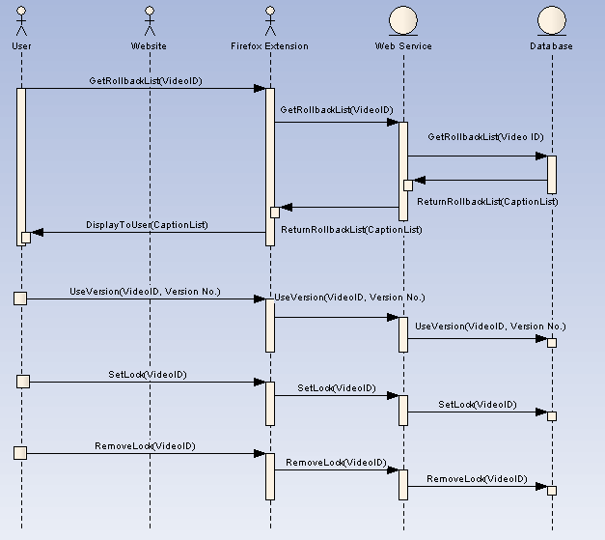
SA: Sequence Diagram
Get Rollback list for a caption.
Reset a caption to a previous version (UseVersion)
Acquire Lock on a caption
Release Lock on a caption

Slide 14
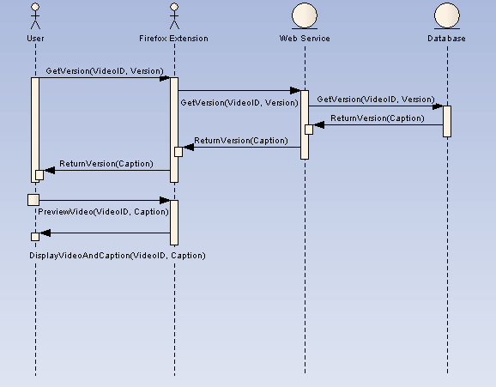
SA: Sequence Diagram
Get previous version of a caption
Preview Video after captioning.

Slide 15
Requirements Document
The Back-End System:
Store, retrieve, modify, and delete captioned videos correctly.
Display the captioned videos where the videos are located.
Assure caption synchronization.
Not allow for automated spamming.
Presents its functionality via Web Services.
Assure that only one user can work on captioning a specific video at a given time.
Store previous caption versions.
Retrieve a list of previous versions.
Revert to a previous version.

Slide 16
Requirements Document
The Front-End System:
Load Videos
Fast-forward in the video
Rewind in the video
Allow entry of captions
Submit captions
Preview the current caption changes with the video.

Slide 17
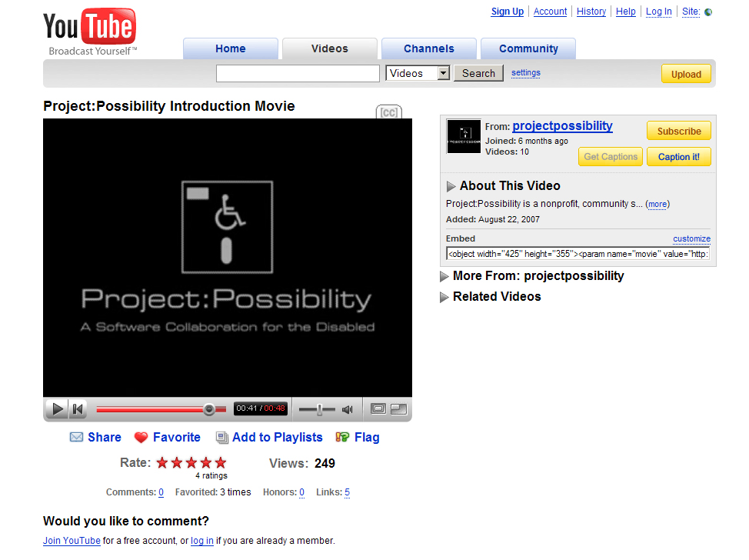
User Interface

Slide 18


Slide 19
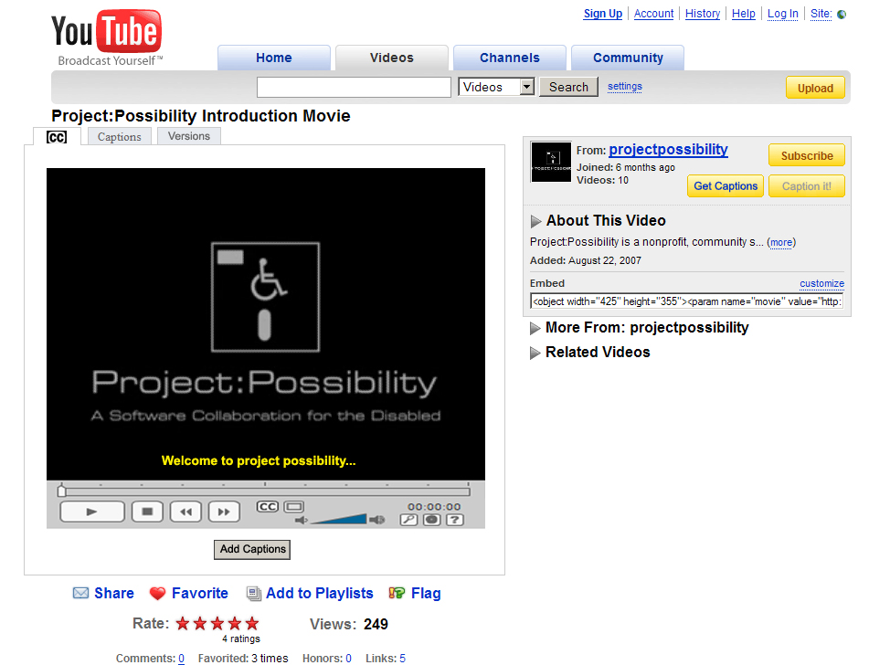

Slide 20
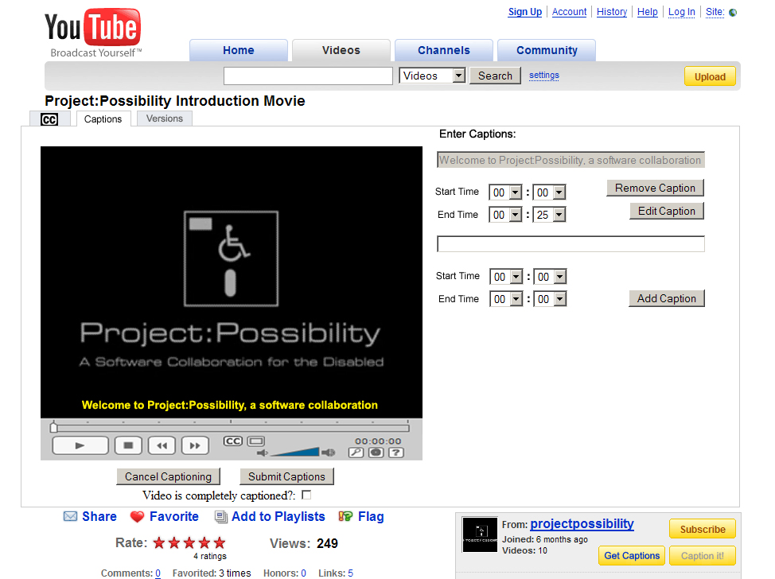

Slide 21
Schedule / Milestones
Define web services interface - March 15th
JavaScript function for re-writing page - March 17th
Web service function JavaScript - March 20th
Parallel Steps:
  Captioning user interface JavaScript - April 1st
  Flash player - April 9th
  Backend implementation - April 9th
JavaScript roll into Firefox extension - April 14th

Slide 22

Q & A

